Slide 1
CSE 4615:: Wireless Networks
Enhancing Insight into
Wireless Transmission Fundamentals
Lecture 4
Course Teacher:
Ashraful Alam Khan
Assistant Professor, CSE, IUT
Content Contributors:
Cory Beard, University of Missouri-Kansas City
William Stallings, Massachusetts Institute of Technology
Sridhar Iyer, IIT Bombay
Jochen Schiller, Freie Universitaet Berlin

Slide 2
CHAPTER 2
TRANSMISSION FUNDAMENTALS
Introduction 1-<number>

Slide 3
CHAPTER 5 & 6 & 7
THE WIRELESS CHANNEL
Introduction 1-<number>

Slide 4
CHAPTER 8
ORTHOGONAL
FREQUENCY DIVISION MULTIPLEXING
Introduction 1-<number>

Slide 5
CHAPTER 9
SPREAD SPECTRUM
Introduction 1-<number>

Slide 6
Physical Layer: Wireless Communication
application
transport
network
link
physical

Slide 7
Antennas

Slide 8
Antennas
An antenna is an electrical conductor or system of conductors to send/receive RF signals
  Transmission - radiates electromagnetic energy into space
  Reception - collects electromagnetic energy from space
In two-way communication, the same antenna can be used for transmission and reception
Omnidirectional Antenna
(lower frequency)
Directional Antenna (higher frequency)
Sridhar Iyer
IIT Bombay

Slide 9
Antennas
Couples Electromagnetic energy to and from space and from a wire or coaxial cable.
Real antennas have directive effect
Directive antennas are used to over come the environmental challenges
Two or more antennas can be combine to improve reception called multi-element antenna array
Antennas should be apart

Slide 10
Antennas: wireless transmission
Antenna
Antenna
Transmitter
Receiver
Wireless communication systems consist of:
  Transmitters
  Antennas: radiates electromagnetic energy into air
  Receivers

Slide 11
Antennas: transmitters
Antenna
Amplifier
Mixer
Filter
Amplifier
Source
Oscillator
Transmitter
Suppose you want to generate a signal that is sent at 900 MHz and
the original source generates a signal at 300 MHz.
  Amplifier - strengthens the initial signal
  Oscillator - creates a carrier wave of 600 MHz
  Mixer - combines signal with oscillator and produces 900 MHz (also does modulation, etc)
  Filter - selects correct frequency
  Amplifier - Strengthens the signal before sending it

Slide 12
Modulation

Slide 13
Modulation
What is modulation and types of modulation?
  Process of converting data into electrical signals optimized for transmission.
roughly divided into four types:
  Analog modulation
  Digital modulation
  Pulse modulation
  Spread spectrum method

Slide 14
Modulation and demodulation
analog
baseband
signal
digital
data
digital
modulation
analog
modulation
101101001
radio transmitter
radio
carrier
analog
baseband
signal
digital
data
analog
demodulation
synchronization
decision
101101001
radio receiver
radio
carrier

Slide 15
Modulation
Digital modulation
  digital data is translated into an analog signal (baseband)
  ASK, FSK, PSK
  differences in spectral efficiency, power efficiency, robustness
Analog modulation
  shifts center frequency of baseband signal up to the radio carrier
Basic schemes
  Amplitude Modulation (AM)
  Frequency Modulation (FM)
  Phase Modulation (PM)

Slide 16
Digital modulation
Modulation of digital signals known as Shift Keying
Amplitude Shift Keying (ASK):
  very simple
  low bandwidth requirements
  very susceptible to interference
Frequency Shift Keying (FSK):
  needs larger bandwidth
Phase Shift Keying (PSK):
  more complex
  robust against interference
1
0
1
t
1
0
1
t
1
0
1
t
Notes:
Universität Karlsruhe
Institut für Telematik
Mobilkommunikation
SS 1998
Prof. Dr. Dr. h.c. G. Krüger
E. Dorner / Dr. J. Schiller

Slide 17
Multiplexing

Slide 18
Multiplexing
channels k_{i}
k₁
k₂
k₃
k₄
k₅
k₆
c
Multiplexing in 4 dimensions
  space (s_{i})
  time (t)
  frequency (f)
  code (c)
Goal: multiple use
of a shared medium
Important: guard spaces needed!
t
c
s₁
t
s₂
f
f
c
t
s₃
f

Slide 19
Frequency multiplex
Separation of the whole spectrum into smaller frequency bands
A channel gets a certain band of the spectrum for the whole time
Advantages:
no dynamic coordination
necessary
works also for analog signals
Disadvantages:
waste of bandwidth
if the traffic is
distributed unevenly
inflexible
guard spaces
k₁
k₂
k₃
k₄
k₅
k₆
c
f
t

Slide 20
Time multiplex
A channel gets the whole spectrum for a certain amount of time
Advantages:
only one carrier in the
medium at any time
throughput high even
for many users
Disadvantages:
precise
synchronization
necessary
k₁
k₂
k₃
k₄
k₅
k₆
c
f
t

Slide 21
Time and frequency multiplex
Combination of both methods
A channel gets a certain frequency band for a certain amount of time
Example: GSM
Advantages:
  better protection against
  tapping
  protection against frequency
  selective interference
  higher data rates compared to
  code multiplex
but: precise coordination
required
k₁
k₂
k₃
k₄
k₅
k₆
c
f
t

Slide 22
Code multiplex
Each channel has a unique code
All channels use the same spectrum at the same time
Advantages:
  bandwidth efficient
  no coordination and synchronization necessary
  good protection against interference and tapping
Disadvantages:
  lower user data rates
  more complex signal regeneration
Implemented using spread spectrum technology
k₁
k₂
k₃
k₄
k₅
k₆
c
f
t

Slide 23
Cognitive Radio
Typically in the form of a spectrum sensing CR
  Detect unused spectrum and share with others avoiding interference
  Choose automatically best available spectrum (intelligent form of time/frequency/space multiplexing)
Distinguish
  Primary Users (PU): users assigned to a specific spectrum by e.g. regulation
  Secondary Users (SU): users with a CR to use unused spectrum
Examples
  Reuse of (regionally) unused analog TV spectrum (aka white space)
  Temporary reuse of unused spectrum e.g. of pagers, amateur radio etc.
f
SU
SU
PU
SU
SU
PU
PU
PU
SU
PU
PU
SU
PU
SU
PU
SU
PU
SU
PU
PU
SU
t
space mux
frequency/time mux

Slide 24
Modulation vs Multiplexing
Aspect | Modulation | Multiplexing
Definition | The process of altering a carrier signal based on the information signal. | The process of combining multiple signals for transmission over a single medium.
Purpose | To adapt a baseband signal for efficient transmission over wireless or wired channels. | To efficiently share a communication channel among multiple signals or users.
Focus | Signal transformation | Signal sharing
Examples | AM, FM, QAM, PSK | TDM (Time Division), FDM (Frequency Division), CDM (Code Division)

Slide 25

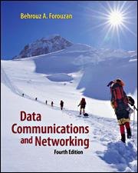
Reference
Chapter 6
Computer Networking: A Top Down Approach
by Jim Kurose, Keith Ross
Chapter 3,5, and 6
Data Communications and Networking
by Behrouz A. Forouzan
6-<number>

Slide 26
Electromagnetic Signal
TRANSMISSION FUNDAMENTALS 2-<number>

Slide 27
Electromagnetic Signal
Function of time
Can also be expressed as a function of frequency
  Signal consists of components of different frequencies
TRANSMISSION FUNDAMENTALS 2-<number>

Slide 28
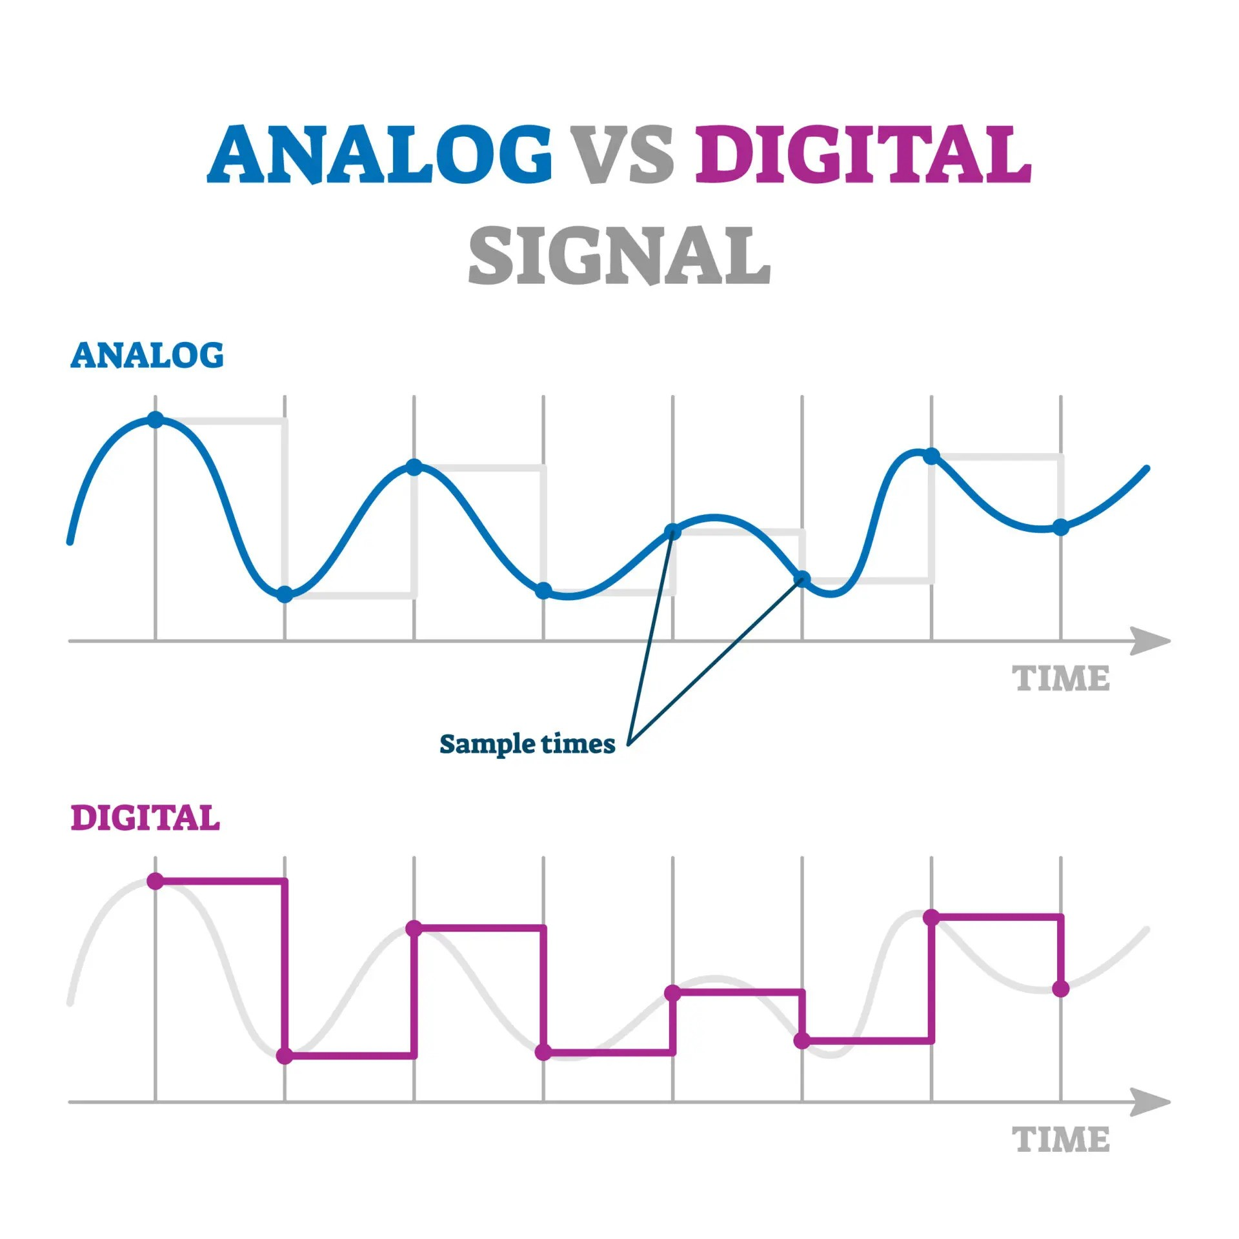
Electromagnetic Signal::
Time-Domain Concepts
Analog signal - signal intensity varies in a smooth fashion over time
  No breaks or discontinuities in the signal
Digital signal - signal intensity maintains a constant level for some period of time and then changes to another constant level
TRANSMISSION FUNDAMENTALS 2-<number>

Slide 29
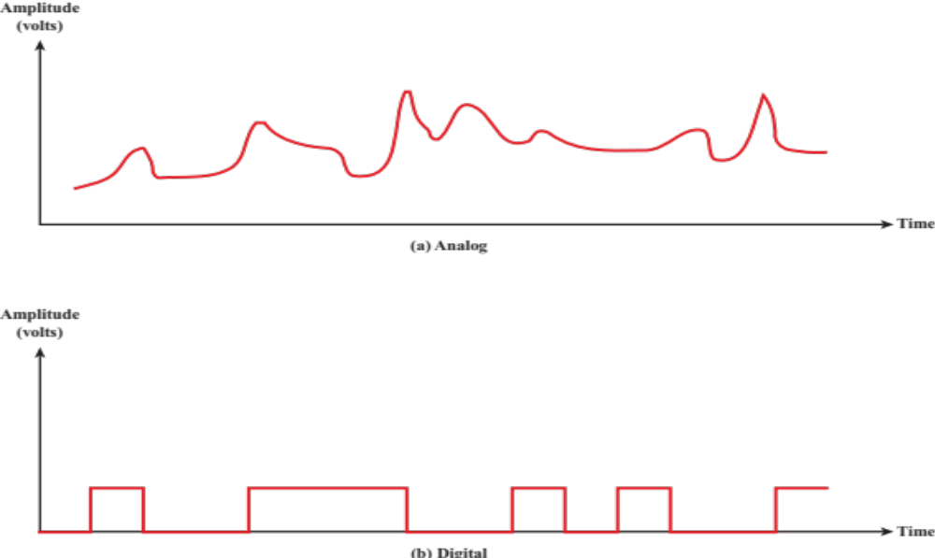
Electromagnetic Signal::
Time-Domain Concepts
TRANSMISSION FUNDAMENTALS 2-<number>

Slide 30
Electromagnetic Signal::
Time-Domain Concepts
Aperiodic signal - analog or digital signal pattern that doesn't repeat over time
Peak amplitude (A) - maximum value or strength of the signal over time; typically measured in volts
Frequency (f)
  Rate, in cycles per second, or Hertz (Hz) at which the signal repeats
TRANSMISSION FUNDAMENTALS 2-<number>

Slide 31
Electromagnetic Signal::
Time-Domain Concepts
Period (T) - amount of time it takes for one repetition of the signal
  T = 1/f
Phase (ϕ) - measure of the relative position in time within a single period of a signal
Wavelength (λ) - distance occupied by a single cycle of the signal
  Or, the distance between two points of corresponding phase of two consecutive cycles
TRANSMISSION FUNDAMENTALS 2-<number>

Slide 32
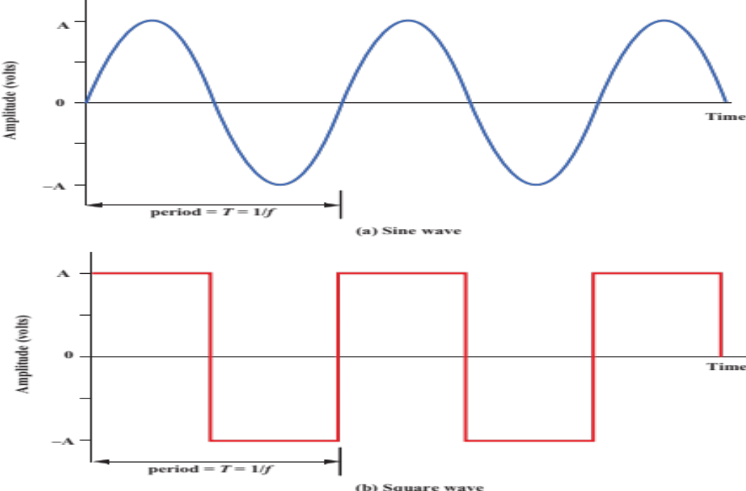

2.2 Examples of Periodic Signals
TRANSMISSION FUNDAMENTALS 2-<number>

Slide 33
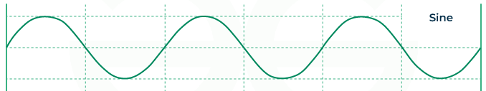
Electromagnetic Signal::
Time-Domain Concepts
Periodic signal - analog or digital signal pattern that repeats over time
  s(t +T) = s(t) -∞ < t < +∞
    where T is the period of the signal
Types of Periodic Signals
  Sinusoidal Wave
  Square Wave
  Triangular Wave
  Sawtooth Wave
Sinusoidal Wave
  shape in the form of sine wave as shown below.
  most common signal used in communication
s(t)=A⋅sin(2πft+ϕ)
TRANSMISSION FUNDAMENTALS 2-<number>

Slide 34
Electromagnetic Signal::
Time-Domain Concepts
Sinusoidal Wave
Where:
A = amplitude (height of the wave)
f = frequency (how fast it oscillates)
t = time
φ = phase (starting position of the wave)
s(t)=A⋅sin(2πft+ϕ)
The phase determines where the sine wave starts on the time axis.
ϕ = Phase shift, measured in radians or degrees
Phase Shift | What Happens
0∘ or 0 rad | Normal sine wave starts at 0 going up
90∘ or π/2 rad | Starts at the wave’s peak
180∘ or π rad | Starts at 0 going down
270∘ or 3π/2 rad | Starts at lowest point
TRANSMISSION FUNDAMENTALS 2-<number>

Slide 35
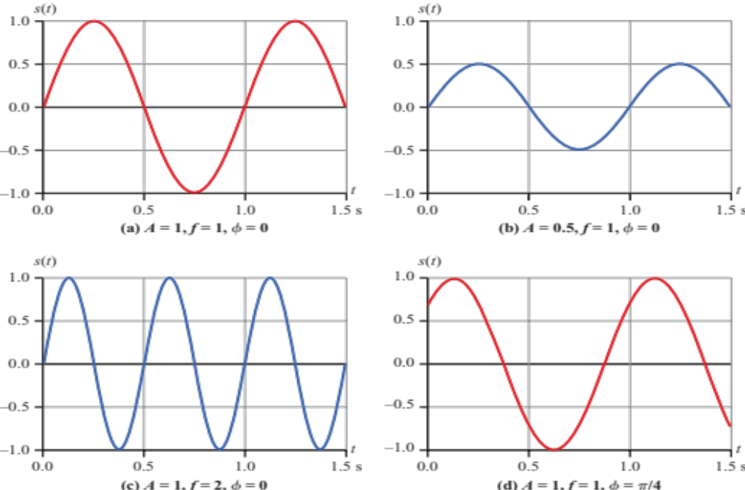

2.3 s(t) = A sin (2πft + ϕ)
TRANSMISSION FUNDAMENTALS 2-<number>

Slide 36
Sine Wave Parameters
General sine wave
  s(t ) = A sin(2πft + ϕ)
Figure 2.3 shows the effect of varying each of the three parameters
  (a) A = 1, f = 1 Hz, ϕ = 0; thus T = 1 s
  (b) Reduced peak amplitude; A=0.5
  (c) Increased frequency; f = 2, thus T = ½
  (d) Phase shift; ϕ = π/4 radians (45 degrees)
Note: 2π radians = 360° = 1 period
TRANSMISSION FUNDAMENTALS 2-<number>

Slide 37
Time vs. Distance
When the horizontal axis is time, as in Figure 2.3, graphs display the value of a signal at a given point in space as a function of time
With the horizontal axis in space, graphs display the value of a signal at a given point in time as a function of distance
  At a particular instant of time, the intensity of the signal varies as a function of distance from the source
TRANSMISSION FUNDAMENTALS 2-<number>

Slide 38
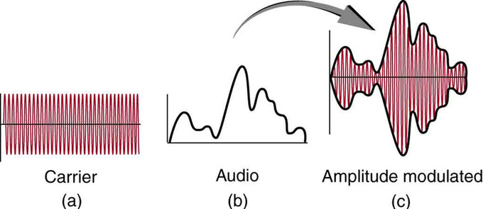
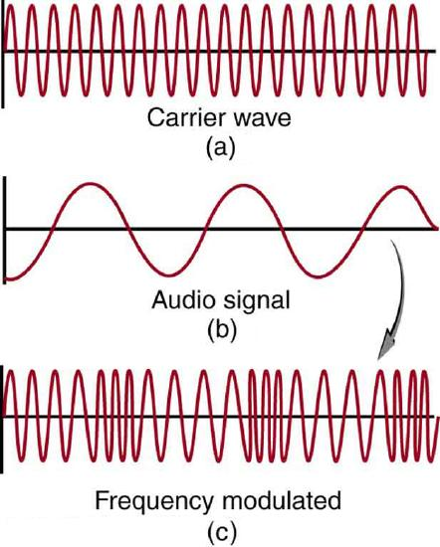
Electromagnetic Signal::
Time-Domain Concepts
In Communication:
A carrier signal is usually a sine wave.
We modulate that sine wave by changing:
  Amplitude → Amplitude Modulation (AM)
  Frequency → Frequency Modulation (FM)
  Phase → Phase Modulation (PM)
OFDM uses multiple sine waves (subcarriers), each orthogonal to the others.
TRANSMISSION FUNDAMENTALS 2-<number>

Slide 39
Electromagnetic Signal::
Frequency-Domain Concepts
Any electromagnetic signal can be shown to consist of a collection of periodic analog signals (sine waves) at different amplitudes, frequencies, and phases
The period of the total signal is equal to the period of the fundamental frequency
TRANSMISSION FUNDAMENTALS 2-<number>

Slide 40
Electromagnetic Signal::
Frequency-Domain Concepts
Fundamental frequency - when all frequency components of a signal are integer multiples of one frequency, it’s referred to as the fundamental frequency
  Example
    Suppose a signal is made of these frequency components:
    50 Hz
    100 Hz
    150 Hz
    200 Hz
    So, 50 Hz is the fundamental frequency
  In systems like :
  Knowing the fundamental frequency helps understand the structure and periodicity of the signal.
  It simplifies design (e.g., subcarrier spacing in OFDM is often based on a fundamental frequency).
TRANSMISSION FUNDAMENTALS 2-<number>

Slide 41
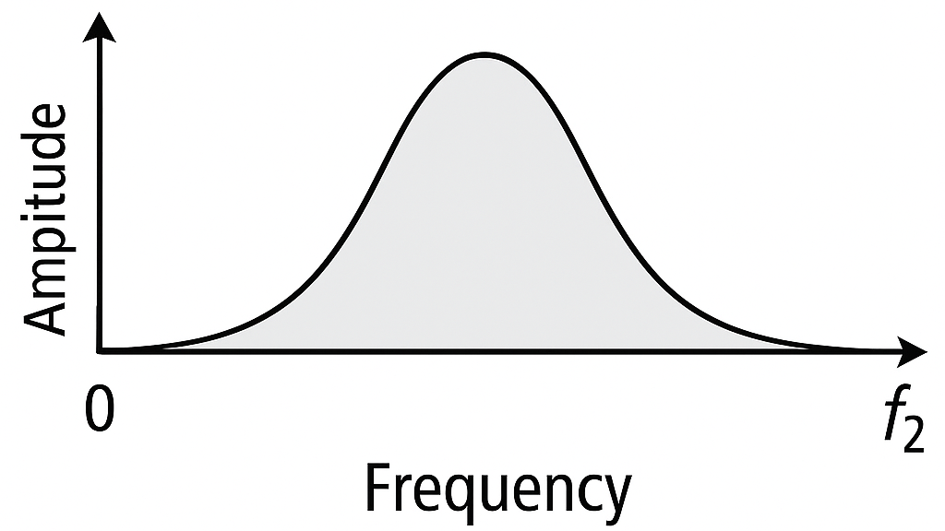
Electromagnetic Signal::
Frequency-Domain Concepts
Spectrum - range of frequencies that a signal contains
TRANSMISSION FUNDAMENTALS 2-<number>

Slide 42
Electromagnetic Signal::
Frequency-Domain Concepts
Absolute bandwidth –
  width of the spectrum of a signal
Effective bandwidth (or just bandwidth) –
  narrow band of frequencies that most of the signal’s energy is contained in
  Focuses on where the signal is strongest.
Example:
  Suppose a signal spans:
  From 100 Hz to 1000 Hz (absolute bandwidth = 900 Hz)
  But 90% of the energy is between 300 Hz to 700 Hz → effective bandwidth = 400 Hz
TRANSMISSION FUNDAMENTALS 2-<number>

Slide 43
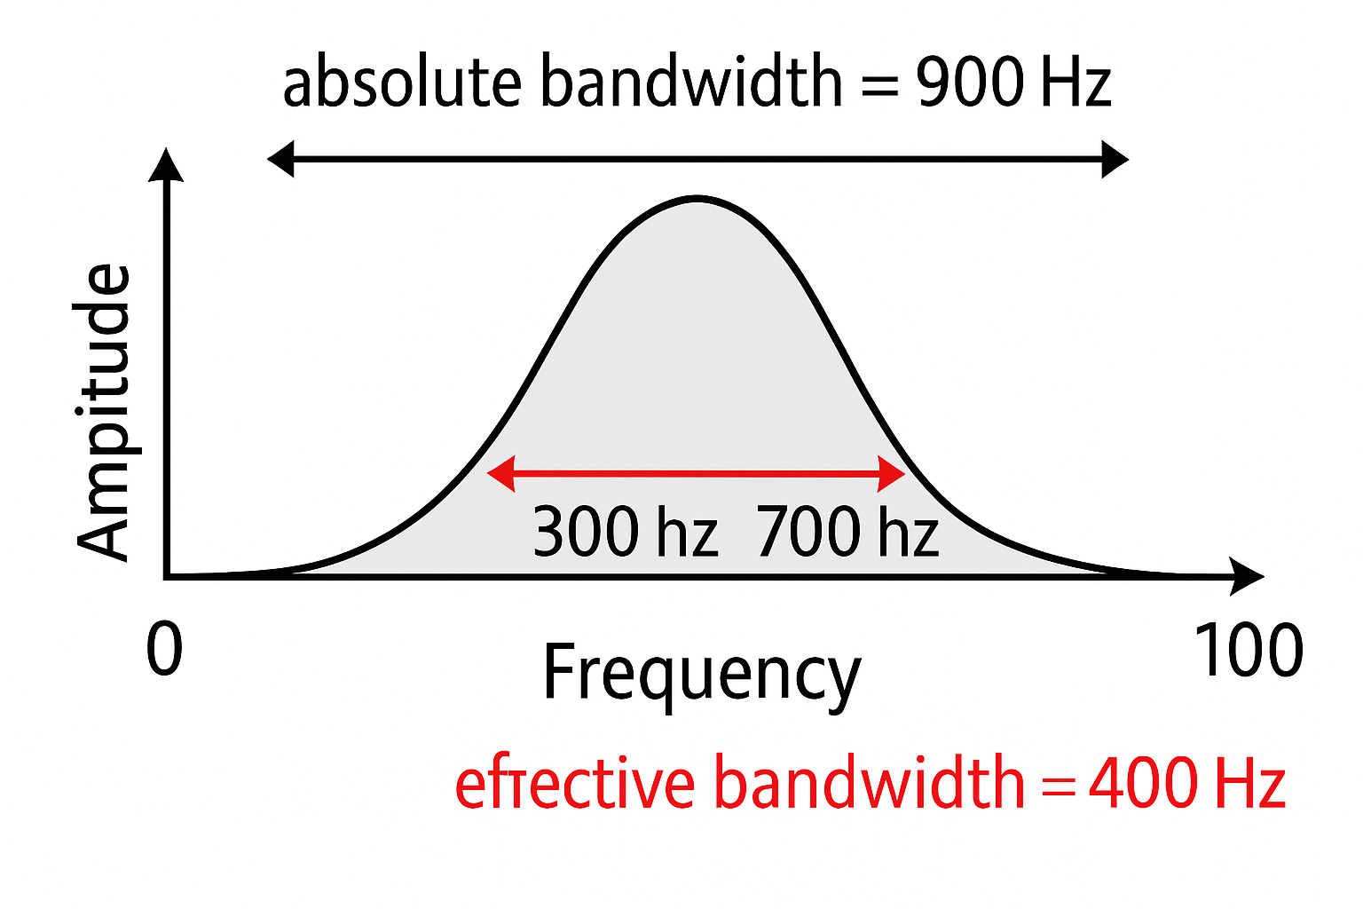
Electromagnetic Signal::
Frequency-Domain Concepts
Example:
  Suppose a signal spans:
  From 100 Hz to 1000 Hz (absolute bandwidth = 900 Hz)
  But 90% of the energy is between 300 Hz to 700 Hz → effective bandwidth = 400 Hz
TRANSMISSION FUNDAMENTALS 2-<number>

Slide 44
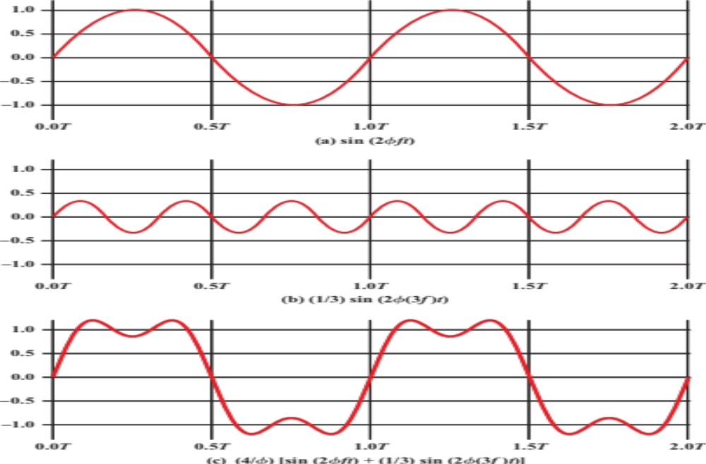

2.4 Addition of frequency Components(T = 1/f)
TRANSMISSION FUNDAMENTALS 2-<number>

Slide 45
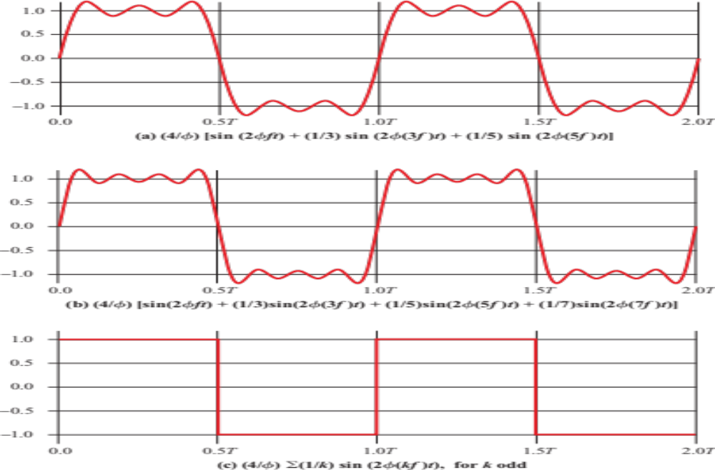

2.5 Frequency Components of Square Wave
TRANSMISSION FUNDAMENTALS 2-<number>

Slide 46
Relationship between Data Rate and Bandwidth
The greater the bandwidth, the higher the information-carrying capacity
Conclusions
  Any digital waveform will have many high-frequency components.
  But in wireless, you can't transmit those infinite frequencies due to antenna, RF front end, and the regulatory spectrum allocation.
  More bandwidth → higher power consumption, more spectrum license fees, more complex hardware (e.g., RFICs, ADCs)
TRANSMISSION FUNDAMENTALS 2-<number>

Slide 47
Relationship between Data Rate and Bandwidth
Conclusions
  Wideband receivers are costlier and more power-hungry (important for phones, IoT devices).
  in multipath environments, not all frequency components reach the receiver equally → signal distortion and errors.
Summary:
In wireless systems, bandwidth is everything:
✔ More bandwidth → higher data rates
✖ But it’s costly, regulated, and hard to handle
✖ Limiting it can degrade performance due to distortion and loss of key signal components
Technology | Bandwidth | Max Data Rate
4G LTE | ~20 MHz | ~100 Mbps
5G mmWave | 400 MHz+ | 1–10 Gbps
TRANSMISSION FUNDAMENTALS 2-<number>

Slide 48
Data Communication Terms
TRANSMISSION FUNDAMENTALS 2-<number>

Slide 49
Data Communication Terms
Data - entities that convey meaning, or information
Signals - electric or electromagnetic representations of data
Transmission - communication of data by the propagation and processing of signals
TRANSMISSION FUNDAMENTALS 2-<number>

Slide 50
Examples of Analog and Digital Data
Analog
  Audio
Digital
  Text
  Integers
TRANSMISSION FUNDAMENTALS 2-<number>

Slide 51
Analog Signals
A continuously varying electromagnetic wave that may be propagated over a variety of media, depending on frequency
Examples of media:
  Copper wire media (twisted pair and coaxial cable)
  Fiber optic cable
  Atmosphere or space propagation
Analog signals can propagate analog and digital data
TRANSMISSION FUNDAMENTALS 2-<number>

Slide 52
Digital Signals
A sequence of voltage pulses that may be transmitted over a copper wire medium
Generally cheaper than analog signaling
Less susceptible to noise interference
Digital signals can propagate analog and digital data
TRANSMISSION FUNDAMENTALS 2-<number>

Slide 53
Digital Signals
Where Digital Signals Are Used in Communication Networks
Technology | Medium | Digital Signal Used Directly? | Notes
Ethernet (LAN) | Copper wire | ✅ Yes | Voltage pulses
Fiber optics | Glass fiber | ✅ Yes | As light pulses
Wi-Fi / Cellular | Air (RF) | ❌ (modulated) | Uses analog RF wave
USB / PCIe / SATA | Copper traces | ✅ Yes | Direct bit-level transfer
TRANSMISSION FUNDAMENTALS 2-<number>

Slide 54
Reasons for Choosing Data and Signal Combinations
Digital data, digital signal
  Equipment for encoding is less expensive than digital-to-analog equipment
  Common in wired LANs (Ethernet) and USB.
Analog data, digital signal
  Conversion permits use of modern digital transmission and switching equipment
  Used in digital telephony
Digital data, analog signal
  Some media (like radio waves or satellites) only support analog waveform propagation.
  Binary data is modulated into an analog carrier wave (e.g., using ASK, FSK, PSK, QAM).
  Used in: Wi-Fi, 4G/5G (QAM), Satellite internet
Analog data, analog signal
  Analog information (like voice) is directly modulated into an analog signal (e.g., AM or FM).
  Used in traditional radio broadcasting, analog telephony
TRANSMISSION FUNDAMENTALS 2-<number>

Slide 55
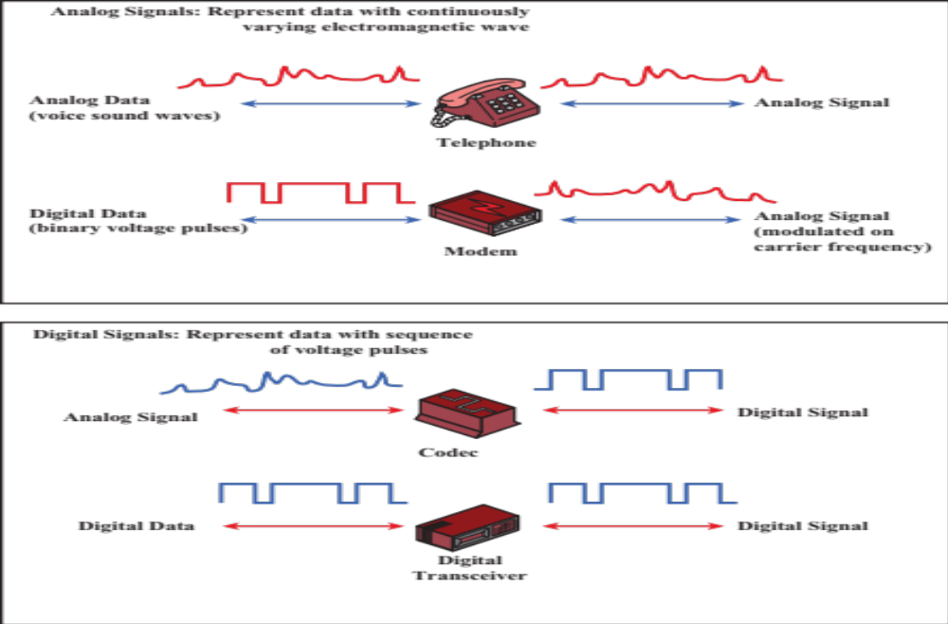

2.8 Analog and Digital Signaling of Analog and Digital Data
TRANSMISSION FUNDAMENTALS 2-<number>

Slide 56
Analog vs Digital Transmission
Feature | Analog Transmission | Digital Transmission
Signal Type | Continuous waveform (e.g., sine wave) | Discrete binary signals (0s and 1s)
Transmission Content | No regard to data content (signal is passed as-is) | Data is encoded and decoded in digital format
Attenuation Handling | Requires amplifiers to boost signal | Uses repeaters to regenerate the original digital signal
Distortion Handling | Analog signals tolerate distortion to some extent | Digital signals are more sensitive to distortion
Amplification Effect | Cascaded amplifiers also amplify noise and distortion | Digital repeaters clean up the signal
Noise Immunity | Lower – analog signal quality degrades with noise | Higher – digital thresholds help recover the original data
TRANSMISSION FUNDAMENTALS 2-<number>

Slide 57
Channel Capacity
TRANSMISSION FUNDAMENTALS 2-<number>

Slide 58
Channel Capacity
Impairments, such as noise, limit data rate that can be achieved
For digital data, to what extent do impairments limit data rate?
Channel Capacity –
the maximum rate at which data can be transmitted over a given communication path, or channel, under given conditions
this concept helps determine the upper limit of data throughput achievable between a transmitter and receiver over a radio link.
TRANSMISSION FUNDAMENTALS 2-<number>

Slide 59
Channel Capacity
Key Factors Influencing Channel Capacity:
Bandwidth (B):
More bandwidth enables higher data rates, but is limited by spectrum regulations.
Interference:
Reduces effective SNR and degrades channel capacity.
Signal-to-Noise Ratio (SNR):
Higher SNR allows better capacity; influenced by transmission power, path loss, and interference.
Fading & Multipath:
Causes signal fluctuations;
Modulation Scheme:
Higher-order modulation increases capacity but demands better SNR.
Coding Efficiency:
Advanced error correction (e.g., LDPC) improves capacity close to the Shannon limit.
Antenna Technologies (e.g., MIMO):
Allows parallel data streams, boosting capacity without additional bandwidth.
TRANSMISSION FUNDAMENTALS 2-<number>

Slide 60

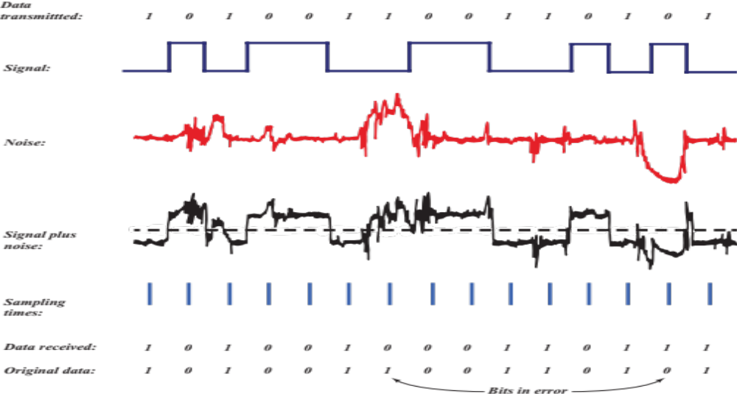
2.9 Effect of Noise on Digital Signal
TRANSMISSION FUNDAMENTALS 2-<number>

Slide 61
Concepts Related to Channel Capacity
Data rate - rate at which data can be communicated (bps)
Bandwidth - the bandwidth of the transmitted signal as constrained by the transmitter and the nature of the transmission medium (Hertz)
Noise - average level of noise over the communications path
Error rate - rate at which errors occur
  Error = transmit 1 and receive 0; transmit 0 and receive 1
TRANSMISSION FUNDAMENTALS 2-<number>

Slide 62
Classifications of Transmission Media
Transmission Medium
  Physical path between transmitter and receiver
Guided Media
  Waves are guided along a solid medium
  E.g., copper twisted pair, copper coaxial cable, optical fiber
Unguided Media
  Provides means of transmission but does not guide electromagnetic signals
  Usually referred to as wireless transmission
  E.g., atmosphere, outer space
TRANSMISSION FUNDAMENTALS 2-<number>

Slide 63
Unguided Media
Transmission and reception are achieved by means of an antenna
Configurations for wireless transmission
  Directional
  Omnidirectional
TRANSMISSION FUNDAMENTALS 2-<number>

Slide 64
Frequency Spectrum
TRANSMISSION FUNDAMENTALS 2-<number>

Slide 65
Frequency Spectrum
Spectrum - range of frequencies that a signal contains
TRANSMISSION FUNDAMENTALS 2-<number>

Slide 66
Spectrum considerations
Controlled by regulatory bodies
  Carrier frequency
  Signal Power
  Multiple Access Scheme
    Divide into time slots –Time Division Multiple Access (TDMA)
    Divide into frequency bands – Frequency Division Multiple Access (FDMA)
    Different signal encodings – Code Division Multiple Access (CDMA)
Overview of Wireless 5-<number>

Slide 67
Spectrum considerations
Federal Communications Commission (FCC) in the United States regulates spectrum
  Military
  Broadcasting
  Public Safety
  Mobile
  Amateur
  Government exclusive, non-government exclusive, or both
  Many other categories
Overview of Wireless 5-<number>

Slide 68
Spectrum considerations
Industrial, Scientific, and Medical (ISM) bands
  Can be used without a license
  As long as power and spread spectrum regulations are followed
ISM bands are used for
  WLANs
  Wireless Personal Area networks
  Internet of Things
Overview of Wireless 5-<number>

Slide 69
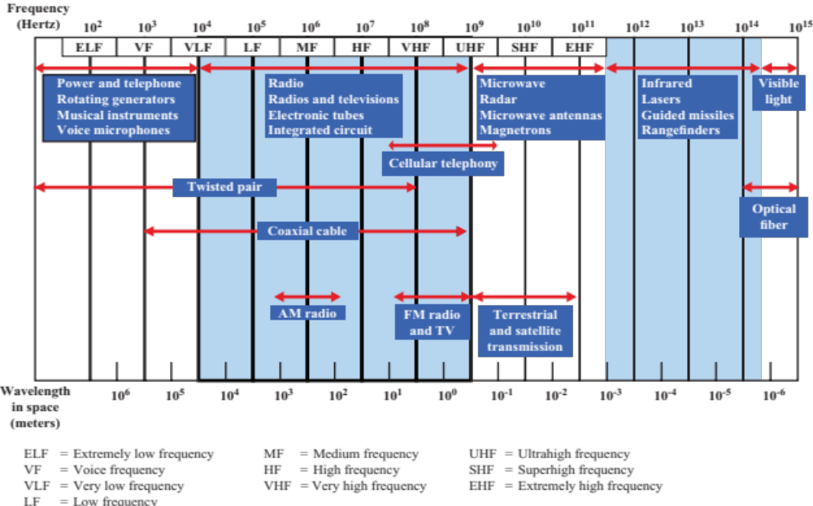
2.10 Electromagnetic spectrum of Telecommunications
Frequency Spectrum
TRANSMISSION FUNDAMENTALS 2-<number>

Slide 70
Frequencies for communication
Frequency Spectrum
VLF = Very Low Frequency UHF = Ultra High Frequency
LF = Low Frequency SHF = Super High Frequency
MF = Medium Frequency EHF = Extra High Frequency
HF = High Frequency UV = Ultraviolet Light
VHF = Very High Frequency
Frequency and wave length
  λ = c/f
  wave length λ, speed of light c ≅ 3x108m/s, frequency f
twisted pair
coax cable
optical transmission
1 Mm
300 Hz
10 km
30 kHz
100 m
3 MHz
1 m
300 MHz
10 mm
30 GHz
100 μm
3 THz
1 μm
300 THz
VLF
LF
MF
HF
VHF
UHF
SHF
EHF
infrared
visible light
UV
Notes:
Universität Karlsruhe
Institut für Telematik
Mobilkommunikation
SS 1998
Prof. Dr. Dr. h.c. G. Krüger
E. Dorner / Dr. J. Schiller

Slide 71
Example frequencies for mobile communication
Frequency Spectrum
VHF-/UHF-ranges for mobile radio
  simple, small antenna for cars
  deterministic propagation characteristics, reliable connections
SHF and higher for directed radio links, satellite communication
  small antenna, beam forming
  large bandwidth available
Wireless LANs use frequencies in UHF to SHF range
  some systems planned up to EHF
  limitations due to absorption by, e.g., water (dielectric heating, see microwave oven)
    weather dependent fading, signal loss caused by heavy rainfall etc.
Prof. Dr.-Ing. Jochen H. Schiller www.jochenschiller.de MC - 2015
Notes:
Universität Karlsruhe
Institut für Telematik
Mobilkommunikation
SS 1998
Prof. Dr. Dr. h.c. G. Krüger
E. Dorner / Dr. J. Schiller

Slide 72
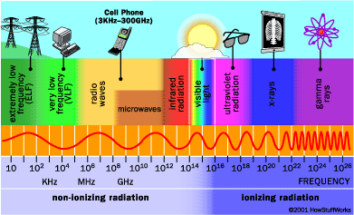
Frequency Spectrum
TRANSMISSION FUNDAMENTALS 2-<number>

Slide 73
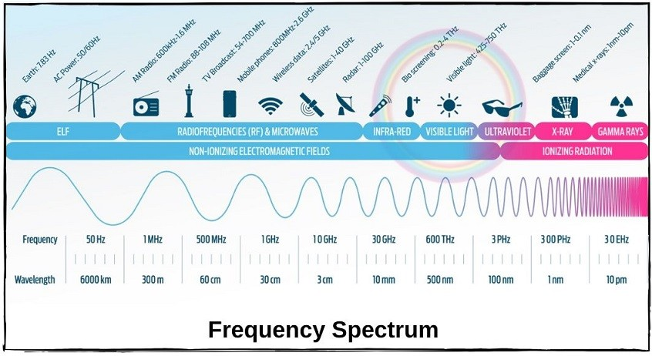
Frequency Spectrum
TRANSMISSION FUNDAMENTALS 2-<number>

Slide 74
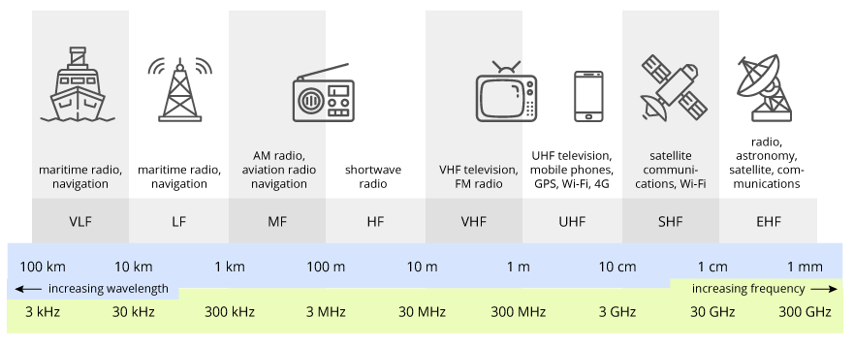
Frequency Spectrum
TRANSMISSION FUNDAMENTALS 2-<number>

Slide 75
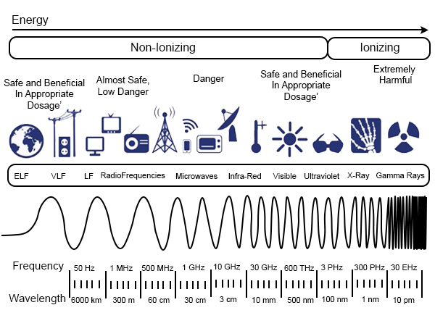
Frequency Spectrum
TRANSMISSION FUNDAMENTALS 2-<number>

Slide 76
Wireless Transmission Frequencies
3 x 10¹¹ to 2 x 10¹⁴
  Infrared
  Local
  Line of sight (or reflection)
  Blocked by walls
  e.g. TV remote control, IRD port
1GHz to 30GHz
  Microwave
  Highly directional
  Point to point
  Satellite
30MHz to 1GHz
  Omnidirectional
  Broadcast radio

Slide 77
Types of Wireless Transmission on Wireless Channel::
Radio and Microwave Transmission
Type | Medium | Direction | Frequency Range | Description & Use
1. Terrestrial Microwave Transmission | Earth-to-Earth | Line-of-sight | 1–30 GHz | Highly directional Point to point
2. Satellite Microwave Transmission | Earth-to-Satellite | Long-range | Uplink: 5.9–6.4 GHz Downlink: 3.7–4.2 GHz | Long-range communication via satellites (TV, GPS)
3. Broadcast Radio Transmission | Tower-to-Many | Omnidirectional | AM: 535–1605 kHz FM: 88–108 MHz | Mass public communication for entertainment & alerts
TRANSMISSION FUNDAMENTALS 2-<number>

Slide 78
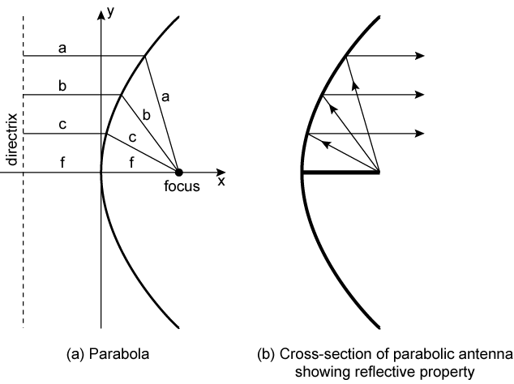
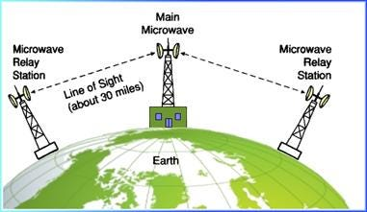
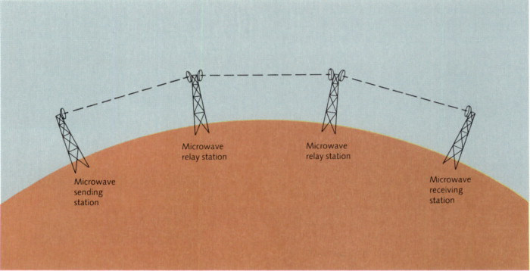
1. Terrestrial Microwave
Parabolic dish
Focused beam
Line of sight
Long haul telecommunications
Higher frequencies give higher data rates

Slide 79
1. Terrestrial Microwave
Definition:
Microwave communication between two ground-based antennas, typically mounted on towers or buildings.
Frequency Range:
Usually between 1 GHz to 30 GHz.
Description of Common Microwave Antenna:
Uses a parabolic “dish”, around 3 meters in diameter.
Antennas are rigidly fixed and focus a narrow beam.
Requires line-of-sight transmission to the receiving antenna.
Antennas are mounted at substantial heights above ground level to avoid obstructions.
How it works:
Line-of-sight transmission ensures high-speed communication with low attenuation over long distances.
Applications:
Long-haul telecommunications services (e.g., inter-city links, WiMAX [Worldwide Interoperability for Microwave Access]).
Short point-to-point links between buildings, such as for corporate or campus networks.
TRANSMISSION FUNDAMENTALS 2-<number>

Slide 80
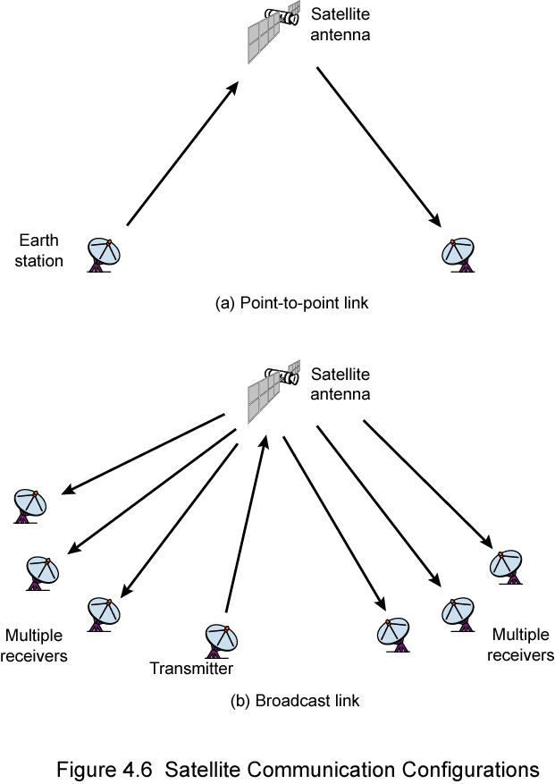
2. Satellite Microwave
Satellite Point to Point Link

Slide 81
2. Satellite Microwave
Satellite Broadcast Link

Slide 82
2. Satellite Microwave
Satellite is relay station
Satellite receives on one frequency, amplifies or repeats signal and transmits on another frequency
Requires geo-stationary orbit
  Height of 35,784km
Television
Long distance telephone
Private business networks

Slide 83
Satellite Microwave
Definition:
Microwave communication between Earth stations and satellites orbiting the Earth.
Frequency Range:
Uplink (Earth to satellite): ~5.9–6.4 GHz
Downlink (Satellite to Earth): ~3.7–4.2 GHz
(Ranges vary by band – C, Ku, Ka, etc.)
How it works:
Ground station transmits to a satellite (uplink).
Satellite retransmits the signal to another ground station (downlink).
Useful for global coverage, even in remote areas.
Applications ?:
TV broadcasting
GPS and navigation
Internet in remote areas
International voice and data communication
TRANSMISSION FUNDAMENTALS 2-<number>

Slide 84
3. Broadcast Radio
Omnidirectional
FM radio
UHF and VHF television
Line of sight
Suffers from multipath interference
  Reflections

Slide 85
3. Broadcast Radio
Definition:
Traditional radio communication from a single broadcasting tower to many receivers.
Frequency Range:
AM radio: 535–1605 kHz
FM radio: 88–108 MHz
How it works:
A central antenna broadcasts signals in an omnidirectional pattern.
Can cover large geographic areas depending on frequency and power.
Applications:
AM/FM radio services
Emergency broadcasts
Public announcements
Mass public communication for entertainment & alerts
TRANSMISSION FUNDAMENTALS 2-<number>

Slide 86
3. Broadcast Radio
AM/FM radio services
Feature | AM (Amplitude Modulation) | FM (Frequency Modulation)
Full Name | Amplitude Modulation | Frequency Modulation
Carrier Frequency Band | 535 – 1605 kHz (kilohertz) | 88 – 108 MHz (megahertz)
Modulation | Information is encoded by varying amplitude of the carrier wave | Information is encoded by varying frequency of the carrier wave
Sound Quality | Lower (more noise-sensitive) | Higher (better resistance to noise)
Why the Difference?
AM is cheaper and travels farther, but more affected by noise like lightning or electrical equipment.
FM uses more bandwidth and is more complex, but delivers clearer sound and is less prone to interference.
Intuitive Explanation:
AM is like shouting louder or softer (amplitude changes).
FM is like changing the pitch/tone (frequency changes) to carry the same message.
TRANSMISSION FUNDAMENTALS 2-<number>

Slide 87
Wireless Propagation Modes
Signal travels along three routes
  Ground wave
    Follows contour of earth
    Up to 2MHz
    AM radio
  Sky wave
    Amateur radio, BBC world service, Voice of America
    Signal reflected from ionosphere layer of upper atmosphere
    (Actually refracted)
  Line of sight
    Above 30Mhz
    May be further than optical line of sight due to refraction
    More later…

Slide 88
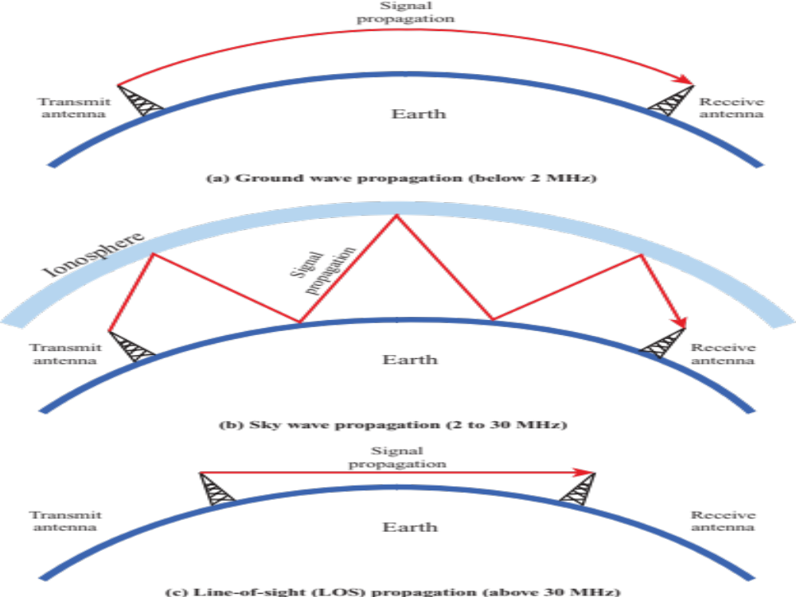

Wireless Propagation Modes
Wireless Propagation Modes
Overview of Wireless 5-<number>

Slide 89
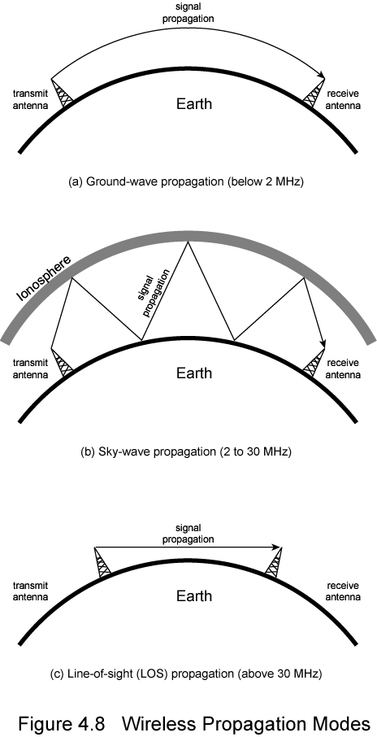
Ground Wave Propagation

Slide 90
Ground Wave Propagation
Follows contour of the earth
Can propagate considerable distances
Frequencies up to 2 MHz
Example
  AM radio
Overview of Wireless 5-<number>

Slide 91
Sky Wave Propagation

Slide 92
Sky Wave Propagation
Signal reflected from ionized layer of atmosphere back down to earth
Signal can travel a number of hops, back and forth between ionosphere and earth’s surface
Reflection effect caused by refraction
Examples
  Amateur radio
  CB radio
Overview of Wireless 5-<number>

Slide 93
Line of Sight Propagation

Slide 94
Line of Sight Transmission
Free space loss
  Signal disperses with distance
  Greater for lower frequencies (longer wavelengths)
Atmospheric Absorption
  Water vapour and oxygen absorb radio signals
  Water greatest at 22GHz, less below 15GHz
  Oxygen greater at 60GHz, less below 30GHz
  Rain and fog scatter radio waves
Multipath
  Better to get line of sight if possible
  Signal can be reflected causing multiple copies to be received
  May be no direct signal at all
  May reinforce or cancel direct signal
Refraction
  May result in partial or total loss of signal at receiver

Slide 95
Line-of-Sight Propagation
Transmitting and receiving antennas must be within line of sight
  Satellite communication – signal above 30 MHz not reflected by ionosphere
  Ground communication – antennas within effective line of site due to refraction
Refraction – bending of microwaves by the atmosphere
  Velocity of electromagnetic wave is a function of the density of the medium
  When wave changes medium, speed changes
  Wave bends at the boundary between mediums
Overview of Wireless 5-<number>

Slide 96
The Effects of Multipath Propagation
Reflection, diffraction, and scattering
Multiple copies of a signal may arrive at different phases
  If phases add destructively, the signal level relative to noise declines, making detection more difficult
Intersymbol interference (ISI)
  One or more delayed copies of a pulse may arrive at the same time as the primary pulse for a subsequent bit
Rapid signal fluctuations
  Over a few centimeters
Overview of Wireless 5-<number>

Slide 97
Propagation Mechanisms
Free-space propagation
Transmission
  Through a medium
  Refraction occurs at boundaries
Reflections
  Waves impinge upon surfaces that are large compared to the signal wavelength
Diffraction
  Secondary waves behind objects with sharp edges
Scattering
  Interactions between small objects or rough surfaces
Overview of Wireless 5-<number>

Slide 98
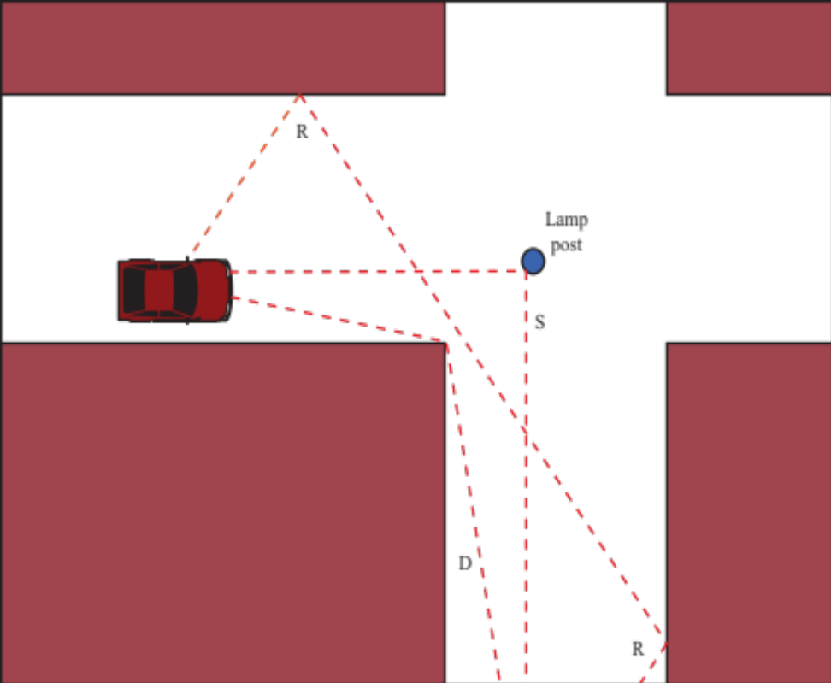

Sketch of Three Important Propagation Mechanisms
Propagation Mechanisms
R= Reflections
D = Diffraction
S = Scattering
Overview of Wireless 5-<number>

Slide 99
Antennas
An antenna is an electrical conductor or system of conductors
  Transmission - radiates electromagnetic energy into space
  Reception - collects electromagnetic energy from space
In two-way communication, the same antenna can be used for transmission and reception but not at the same time.
Overview of Wireless 5-<number>

Slide 100
Attenuation
Strength of signal falls off with distance over transmission medium
Attenuation factors for unguided media:
  Received signal must have sufficient strength so that circuitry in the receiver can interpret the signal
  Signal must maintain a level sufficiently higher than noise to be received without error
  Attenuation is greater at higher frequencies, causing distortion
Overview of Wireless 5-<number>

Slide 101
Loss Models Derived from Empirical Measurements
Need to design systems based on empirical data applied to a particular environment
  To determine power levels, tower heights, height of mobile antennas
Okumura developed a model, later refined by Hata
  Detailed measurement and analysis of the Tokyo area
  Among the best accuracy in a wide variety of situations
Predicts path loss for typical environments
  Urban
  Small, medium sized city
  Large city
  Suburban
  Rural
Overview of Wireless 5-<number>

Slide 102
Categories of Noise
Thermal Noise
Intermodulation noise
Crosstalk
Impulse Noise
Overview of Wireless 5-<number>

Slide 103
Thermal Noise
Thermal noise due to agitation of electrons
Present in all electronic devices and transmission media
Cannot be eliminated
Function of temperature
Particularly significant for satellite communication
Overview of Wireless 5-<number>

Slide 104
Noise Terminology
Intermodulation noise – occurs if signals with different frequencies share the same medium
  Interference caused by a signal produced at a frequency that is the sum or difference of original frequencies
Crosstalk – unwanted coupling between signal paths
Impulse noise – irregular pulses or noise spikes
  Short duration and of relatively high amplitude
  Caused by external electromagnetic disturbances, or faults and flaws in the communications system
Overview of Wireless 5-<number>

Slide 105
Other Impairments
Atmospheric absorption – water vapor and oxygen contribute to attenuation
Multipath – obstacles reflect signals so that multiple copies with varying delays are received
Refraction – bending of radio waves as they propagate through the atmosphere
Overview of Wireless 5-<number>

Slide 106
The Trouble with Wireless
Introduction 1-<number>

Slide 107
The trouble with wireless
Wireless is convenient and less expensive, but not perfect
Limitations and political and technical difficulties inhibit wireless technologies
Wireless channel
  Line-of-sight is best but not required
  Signals can still be received
    Transmission through objects
    Reflections off of objects
    Scattering of signals
    Diffraction around edges of objects
Introduction 1-<number>

Slide 108
The trouble with wireless
Wireless channel
  Reflections can cause multiple copies of the signal to arrive
    At different times and attenuations
    Creates the problem of multipath fading
    Signals add together to degrade the final signal
  Noise
  Interference from other users
  Doppler spread caused by movement
Introduction 1-<number>

Slide 109
Combating Problems of Wirelesss
Introduction 1-<number>

Slide 110
Combating problems:: Modulation
Modulation
  Map the digital data onto analog signals
  Modulation is the process of changing a carrier signal to carry information (data).
  Goal: Send more bits per signal.
  In Wireless, the Carrier is a Sine Wave
  To send data, we modulate:
    Amplitude (A) → Amplitude Shift Keying (ASK)
    Frequency (f) → Frequency Shift Keying (FSK)
    Phase (φ) → Phase Shift Keying (PSK)
    Or combinations → QAM (Quadrature Amplitude Modulation)
  How This Works Visually: QPSK
    Let’s say we want to send 4 different symbols using QPSK:
    We assign 00, 01, 10, 11 to four different phase angles of the carrier signal.
    These are all sine waves of the same frequency, but with different starting points (phase shifts).
Introduction 1-<number>

Slide 111
Combating problems:: Modulation
Modulation
  Visual Analogy:
  Imagine each subcarrier is a musical note 🎵.
  You can make it louder/quieter (amplitude) or change the timing (phase) to send secret messages — that's modulation!
Concept | In Modulation
Input | Digital bits (e.g., 1010...)
Carrier wave | Sine wave at a certain frequency
Output | Modified wave carrying data
Visualization | Shift in wave’s amplitude/phase/frequency
Introduction 1-<number>

Slide 112
Combating problems:: Error Coding & Equalization
Error Control Coding
  Adds extra bits to detect and fix errors.
  Example: Like adding a checksum or parity bits in your data so you can spot and fix mistakes.
Adaptive Modulation and Coding
  Dynamically adjusts modulation/coding based on signal quality.
  Example: If the signal is weak, switch to safer but slower mode; if strong, go faster.
Equalization
  Reduces effects of multipath, where signals bounce and cause distortion.
  Example: Like tuning your ear to separate overlapping echoes in a large hall.
Introduction 1-<number>

Slide 113
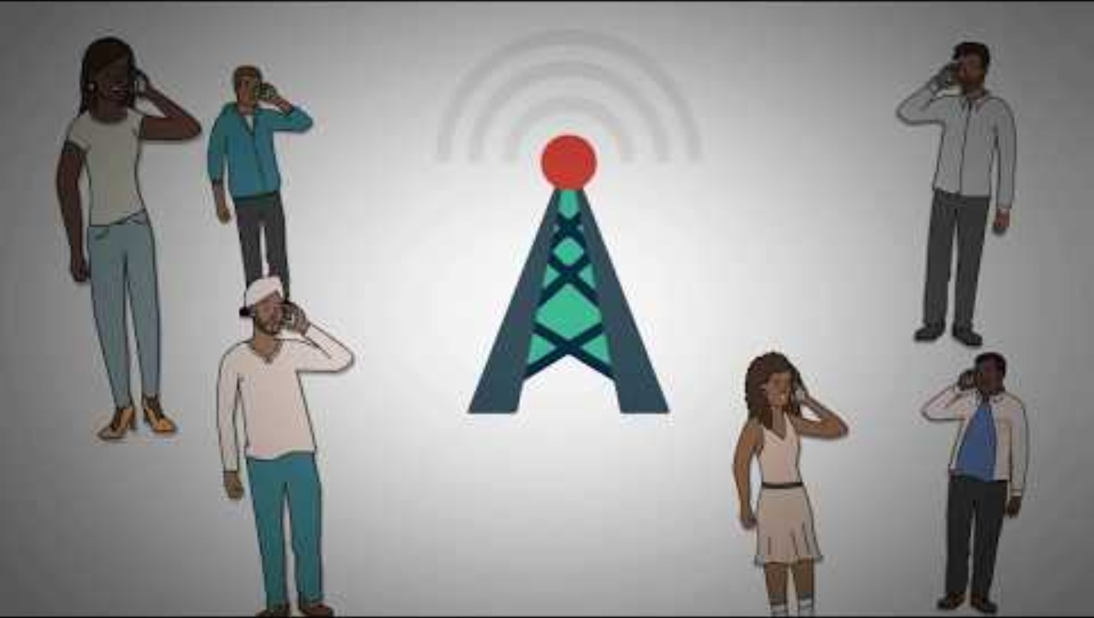
Combating problems:: Multiplexing
Multiplexing & Multiple Access
Introduction 1-<number>

Slide 114
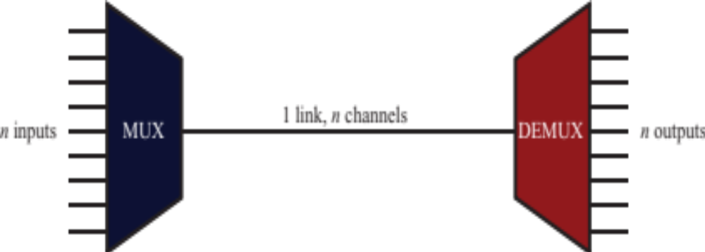
2.11 Multiplexing
Multiplexing
A communication medium (like a cable or channel) can usually carry more data than just one signal.
So, we use multiplexing to send multiple signals at the same time over that medium.
This makes better use of the channel and saves resources.
TRANSMISSION FUNDAMENTALS 2-<number>

Slide 115
Multiplexing
Frequency-division multiplexing (FDM)
  Takes advantage of the fact that the useful bandwidth of the medium exceeds the required bandwidth of a given signal
Time-division multiplexing (TDM)
  Takes advantage of the fact that the achievable bit rate of the medium exceeds the required data rate of a digital signal
TRANSMISSION FUNDAMENTALS 2-<number>

Slide 116
Combating problems:: Multiplexing
Multiplexing
What it does: Combines multiple data streams for transmission on the same physical medium.
Types:
  Time Division Multiplexing (TDM)
  Frequency Division Multiplexing (FDM)
  Code Division Multiplexing (CDM)
  Space Division Multiplexing (SDM)
Where: implemented at the physical layer (but different function than modulation).
Analogy: Like scheduling multiple speakers to use a single microphone one after another (TDM) or letting them speak at different pitches (FDM).
Multiple Access
Multiple Access refers to how multiple users share the same communication medium simultaneously — it's about who gets to transmit when and how.
Introduction 1-<number>

Slide 117
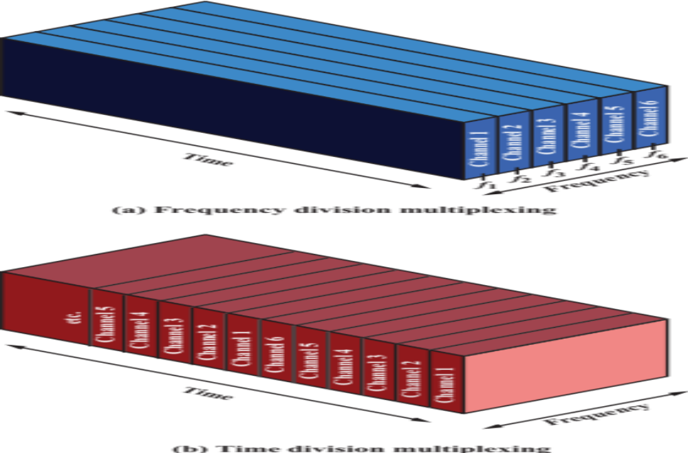

2.12 FDM and TDM
TRANSMISSION FUNDAMENTALS 2-<number>

Slide 118
Reasons for Widespread Use of Multiplexing
Cost per kbps of transmission facility declines with an increase in the data rate
Cost of transmission and receiving equipment declines with increased data rate
Most individual data communicating devices require relatively modest data rate support
TRANSMISSION FUNDAMENTALS 2-<number>

Slide 119
Combating problems::
OFDM
(Orthogonal Frequency Division Multiplexing)
Introduction 1-<number>

Slide 120
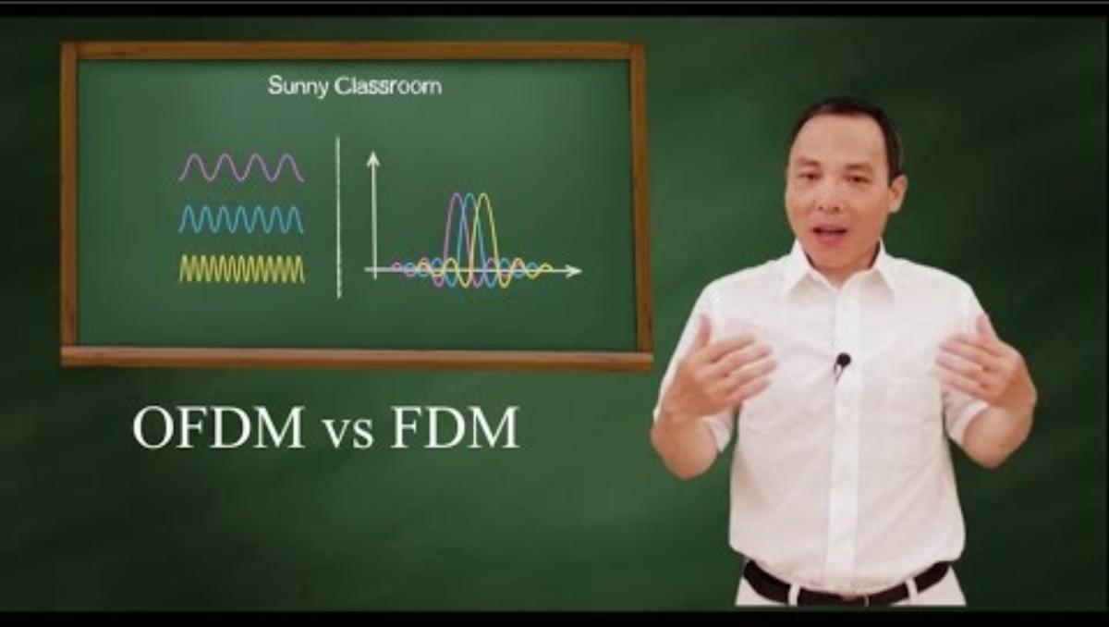
Combating problems:: OFDM
Introduction 1-<number>

Slide 121
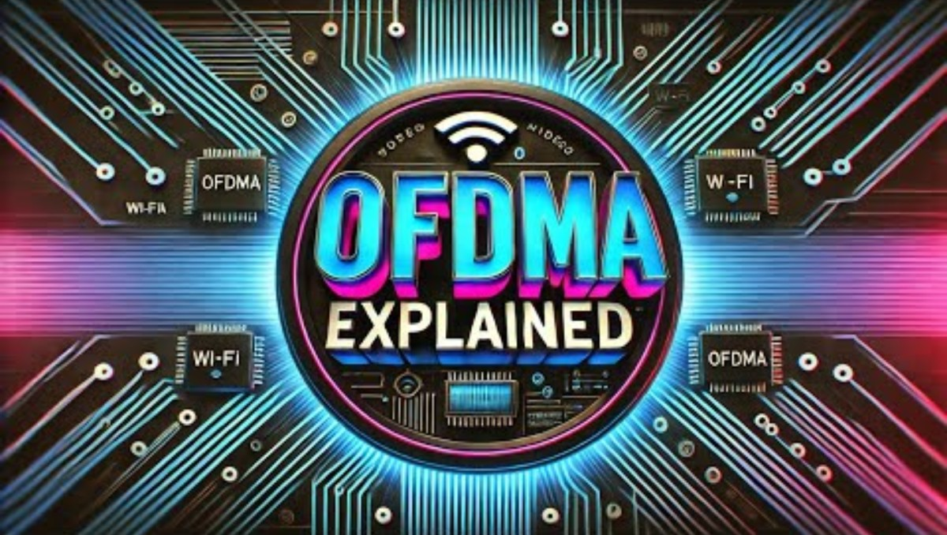
Combating problems:: OFDM
Introduction 1-<number>

Slide 122
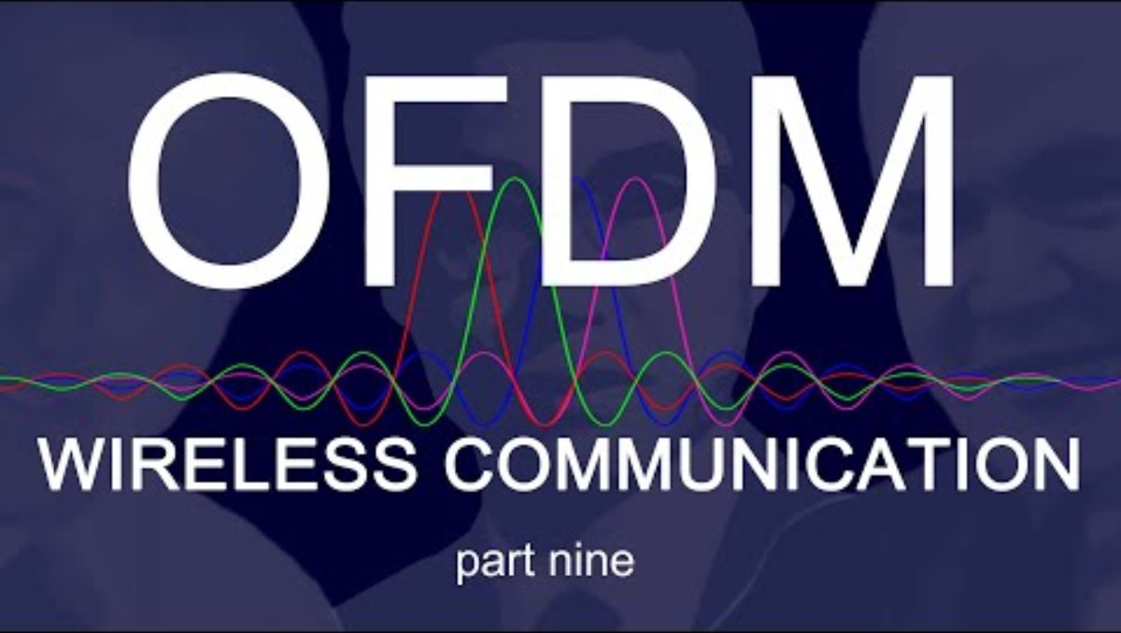
Combating problems:: OFDM
Introduction 1-<number>

Slide 123
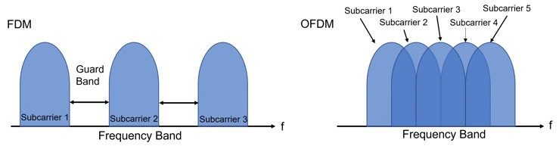
Combating problems:: OFDM
OFDM (Orthogonal Frequency Division Multiplexing):
A signal is divided into multiple low-rate data streams
Transmitted simultaneously over closely spaced orthogonal subcarriers, reducing interference and multipath effects.
Figure: Conceptual diagram of multi-carrier transmission
Introduction 1-<number>

Slide 124
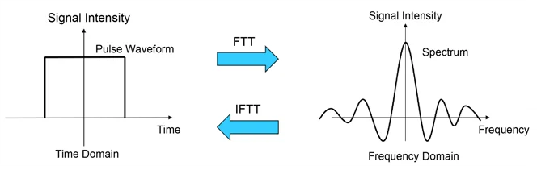
Combating problems:: OFDM
Figure: Representation of signals on the time and frequency axes
Introduction 1-<number>

Slide 125
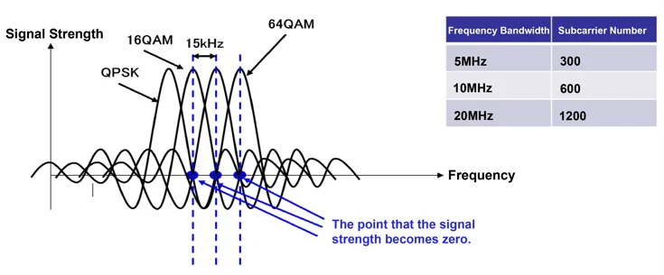
Combating problems:: OFDM
OFDM (Orthogonal Frequency Division Multiplexing):
A signal is divided into multiple low-rate data streams
Transmitted simultaneously over closely spaced orthogonal subcarriers, reducing interference and multipath effects.
Figure: Subcarrier arrangement in OFDM
  Explore : For More Detail's of OFDM
Introduction 1-<number>

Slide 126
Combating problems:: OFDM
OFDM – Dividing Signal into Low-Rate Streams:
  Suppose you want to send a fast stream of 1000 bits/sec.
  Instead of sending it as one fast stream, OFDM splits it into 10 slower streams, each sending 100 bits/sec.
  These streams are then sent simultaneously on different sub-frequencies (subcarriers), which don’t interfere with each other because they are orthogonal.
Simple Analogy:
  Imagine 10 people (subcarriers) speaking slowly at the same time, each in a different room (frequency).
  Even though each speaks slowly, together they deliver the full message quickly and without interference.
  So:
  “Low-rate data streams” = smaller, slower chunks of the original data
  Sent in parallel over multiple frequencies = faster, reliable transmission without overlap.
Introduction 1-<number>

Slide 127
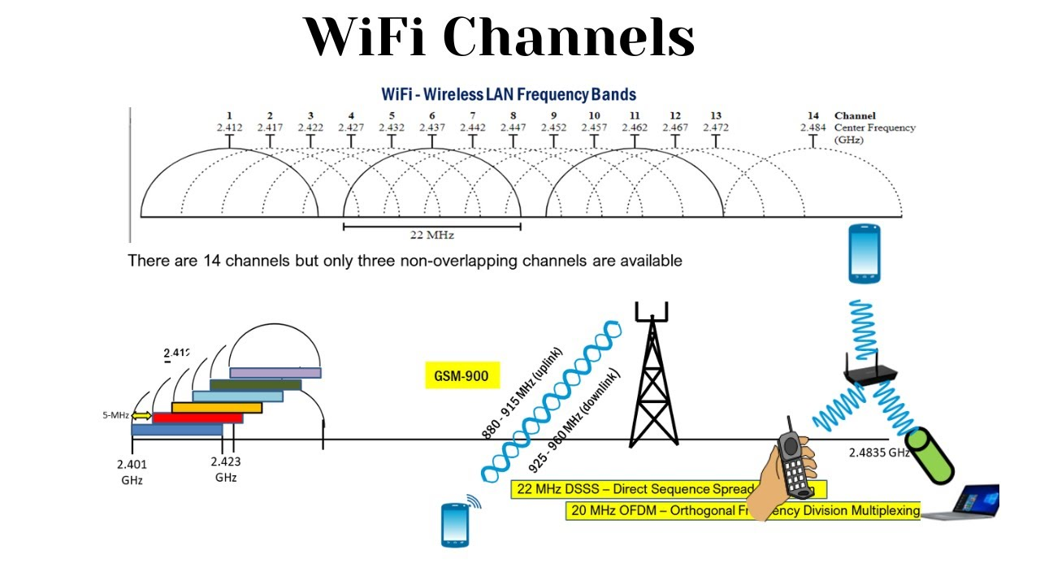
Radio Spectrum:: WiFi Channels
TRANSMISSION FUNDAMENTALS 2-<number>

Slide 128
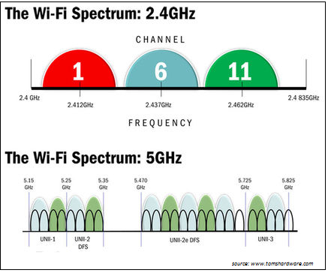
Radio Spectrum:: WiFi Channels
TRANSMISSION FUNDAMENTALS 2-<number>

Slide 129
Combating problems::
MIMO (Multiple-Input Multiple-Output)
Introduction 1-<number>

Slide 130
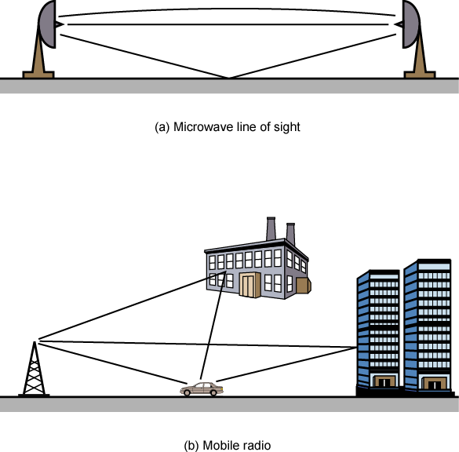
Multipath Propagation

Slide 131
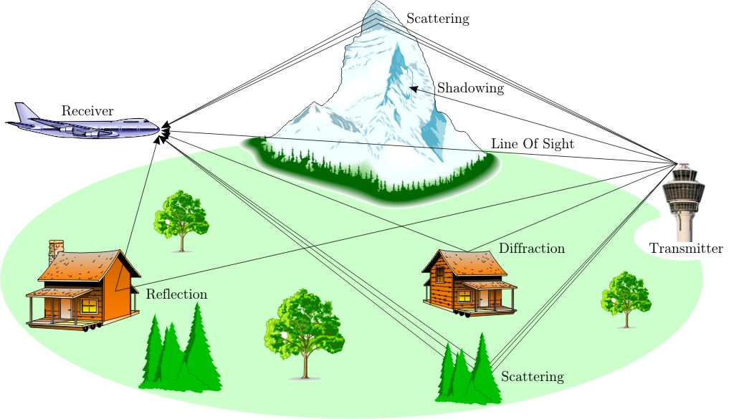
Multipath Propegation & Environmental Obstructions
Multi-path propagation
  Electromagnetic waves reflect off objects
  Taking many paths of different lengths
  Causing blurring of signal at the receiver
receiver
transmitter

Slide 132
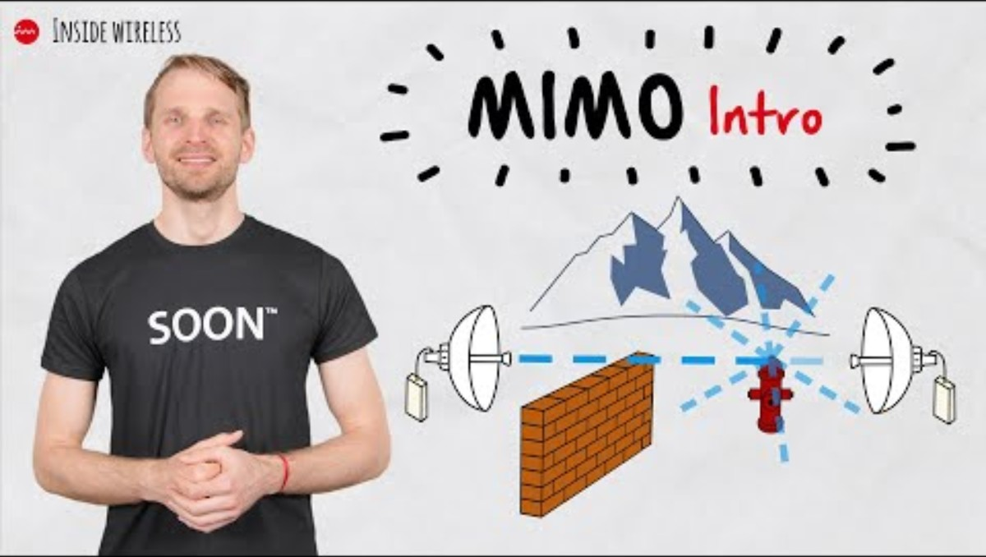
Combating problems:: MIMO
MIMO (Multiple-Input Multiple-Output)
Introduction 1-<number>

Slide 133
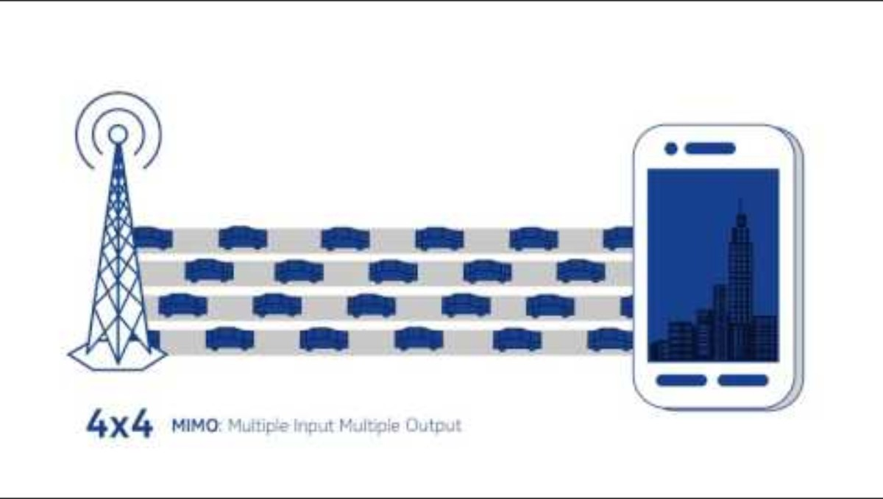
Combating problems:: MIMO
MIMO (Multiple-Input Multiple-Output)
Introduction 1-<number>

Slide 134
Combating problems:: MIMO
MIMO (Multiple-Input Multiple-Output)
  Uses multiple antennas to:
    Send multiple data streams at once (parallel data)
    10s or 100s of antennas to focus antenna beams toward intended devices
  Example: Like using several delivery trucks instead of one to send more packages.
Multiple antennas at the transmitter send multiple data streams simultaneously over the same frequency channel !
  But how is that possible?
  It works by exploiting spatial diversity and multipath propagation in the environment.
  There are two core techniques involved:
    1. Beamforming
    2. Spatial Multiplexing
Introduction 1-<number>

Slide 135
Combating problems:: MIMO
MIMO (Multiple-Input Multiple-Output)
Beamforming
Uses phase shifts across antennas to steer the signal energy in specific angular directions.
This is useful for boosting signal strength in a specific direction, or reducing interference.
Common in massive MIMO (e.g., 5G base stations).
Introduction 1-<number>

Slide 136
Combating problems:: MIMO
MIMO (Multiple-Input Multiple-Output)
2. Spatial Multiplexing
Different antennas transmit different data streams at the same time and on the same frequency.
The receiver, using multiple antennas and smart signal processing (like channel estimation), can separate these overlapping signals.
This increases data rate without needing more bandwidth.
Direction isn't explicitly controlled — instead, it relies on natural differences in path (due to reflections, angles, etc.).
Introduction 1-<number>

Slide 137
Combating problems:: MIMO
Spatial Multiplexing:
Each transmitting antenna sends a different data stream at the same frequency.
Due to the different locations of the transmitting and receiving antennas, and the multipath environment, the signal from each antenna takes slightly different paths and gets mixed differently at each receiver antenna.
The receiver uses this unique "mixture" of signals to separate the original streams using signal processing algorithms.
Analogy:
Imagine 3 people (antennas) shouting different words in a canyon.
The echoes bounce differently to each of 3 listeners (receiver antennas) due to the shape of the rocks (environment).
Even though they all shouted at once, clever listeners can figure out who said what by listening from different spots and analyzing the echo patterns.
Introduction 1-<number>

Slide 138
Combating problems::
OFDM vs MIMO
Similarity:
Both aim to increase data rate and reliability.
Both are used together in modern systems like Wi-Fi 6 and 5G.
Both support parallelism to handle high-speed data efficiently.
Dissimilarity:
Aspect | OFDM | MIMO
Transmission medium | Same antenna, many frequencies | Many antennas, same frequency
Focus | Handles frequency interference (multipath) | Handles spatial diversity/multipath
Hardware need | Can work with 1 antenna | Needs multiple antennas
Simple Analogy:
OFDM is like sending a message split across many radio stations (frequencies) at once
MIMO is like sending different messages from different people (antennas) all at the same time
Introduction 1-<number>

Slide 139
Combating problems::
Spread Spectrum Techniques
Introduction 1-<number>

Slide 140
Combating problems:: Spread Spectrum Techniques
Common Purpose:
To transmit data more reliably and securely by using more bandwidth than the minimum required.
  Frequency Hopping Spread Spectrum (FHSS)
  Direct Sequence Spread Spectrum (DSSS)
These are commonly used in wireless communication systems, especially where interference and security are concerns.
Why this name?
"spread" the original data signal over a wider frequency band than necessary for transmission. This helps in:
  Reducing interference
  Improving security
  Resisting jamming
  Enhancing signal robustness
Introduction 1-<number>

Slide 141
Combating problems:: Spread Spectrum Techniques
Problem of radio transmission:
  frequency dependent fading can wipe out narrow band signals for duration of the interference
Solution:
  spread the narrow band signal into a broad band signal using a special code
Introduction 1-<number>

Slide 142
Combating problems:: Spread Spectrum Techniques
Direct Sequence Spread Spectrum (DSSS)
Idea:
Each bit of the signal is replaced by a longer code (spreading code) that spreads it across a wide frequency range.
Simple Example:
Suppose we want to send 1011. DSSS would spread each bit using a long PN sequence like 110101001.
So, the transmitted signal becomes much longer but more robust.
Even if some bits are lost due to noise, the receiver can still figure out the original data.
  More resistant to noise and eavesdropping.
  Used in older Wi-Fi (802.11b), GPS.
Introduction 1-<number>

Slide 143
Spreading and frequency selective fading
channel
quality
1
2
5
6
3
narrowband channels
4
frequency
narrow band
signal
guard space
channel
quality
2
2
spread spectrum channels
2
2
2
1
frequency
spread
spectrum
Notes:
Universität Karlsruhe
Institut für Telematik
Mobilkommunikation
SS 1998
Prof. Dr. Dr. h.c. G. Krüger
E. Dorner / Dr. J. Schiller

Slide 144
DSSS (Direct Sequence Spread Spectrum)
XOR of the signal with pseudo-random number (chipping sequence)
  many chips per bit (e.g., 128) result in higher bandwidth of the signal
Advantages
  reduces frequency selective
  fading
t_{b}
user data
0
1
XOR
t_{c}
chipping
sequence
0
1
1
0
1
0
1
0
1
1
0
1
0
1
=
resulting
signal
0
1
1
0
1
0
1
1
0
0
1
0
1
0
t_{b}: bit period
t_{c}: chip period
Notes:
Universität Karlsruhe
Institut für Telematik
Mobilkommunikation
SS 1998
Prof. Dr. Dr. h.c. G. Krüger
E. Dorner / Dr. J. Schiller

Slide 145
DSSS (Direct Sequence Spread Spectrum)
spread
spectrum
signal
user data
transmit
signal
X
modulator
chipping
sequence
radio
carrier
transmitter
correlator
lowpass
filtered
signal
products
sampled
sums
received
signal
data
demodulator
X
integrator
decision
radio
carrier
chipping
sequence
receiver
Notes:
Universität Karlsruhe
Institut für Telematik
Mobilkommunikation
SS 1998
Prof. Dr. Dr. h.c. G. Krüger
E. Dorner / Dr. J. Schiller

Slide 146
Combating problems:: Spread Spectrum Techniques
Frequency Hopping Spread Spectrum (FHSS)
Idea:
The signal jumps between different frequencies very fast in a pattern known to both sender and receiver.
Simple Example:
Imagine two people talking using walkie-talkies, but they change channels every second following a shared schedule. Anyone trying to listen without knowing the pattern hears only random noise.
  Helps avoid interference and jamming.
  Used in Bluetooth, military radios.
Introduction 1-<number>

Slide 147
FHSS (Frequency Hopping Spread Spectrum)
Discrete changes of carrier frequency
  sequence of frequency changes determined via pseudo random number sequence
Two versions
  Fast Hopping:
  several frequencies per user bit
  Slow Hopping:
  several user bits per frequency
Advantages
  frequency selective fading and interference limited to short period
  simple implementation
  uses only small portion of spectrum at any time
Disadvantages
  not as robust as DSSS
  simpler to detect
Notes:
Universität Karlsruhe
Institut für Telematik
Mobilkommunikation
SS 1998
Prof. Dr. Dr. h.c. G. Krüger
E. Dorner / Dr. J. Schiller

Slide 148
FHSS (Frequency Hopping Spread Spectrum)
t_{b}
user data
0
1
0
1
1
t
f
t_{d}
f₃
slow
hopping
(3 bits/hop)
f₂
f₁
f
t_{d}
t
f₃
fast
hopping
(3 hops/bit)
f₂
f₁
t
t_{b}: bit period t_{d}: dwell time
Notes:
Universität Karlsruhe
Institut für Telematik
Mobilkommunikation
SS 1998
Prof. Dr. Dr. h.c. G. Krüger
E. Dorner / Dr. J. Schiller

Slide 149
FHSS (Frequency Hopping Spread Spectrum)
narrowband
signal
spread
transmit
signal
user data
modulator
modulator
frequency
synthesizer
hopping
sequence
transmitter
narrowband
signal
received
signal
data
demodulator
demodulator
hopping
sequence
frequency
synthesizer
receiver
Notes:
Universität Karlsruhe
Institut für Telematik
Mobilkommunikation
SS 1998
Prof. Dr. Dr. h.c. G. Krüger
E. Dorner / Dr. J. Schiller

Slide 150
Software Defined Radio
Basic idea (ideal world)
  Full flexibility wrt modulation, carrier frequency, coding…
  Simply download a new radio!
  Transmitter: digital signal processor plus very fast D/A-converter
  Receiver: very fast A/D-converter plus digital signal processor
Real world
  Problems due to interference, high accuracy/high data rate, low-noise amplifiers needed, filters etc.
Examples
  Joint Tactical Radio System
  GNU Radio, Universal Software Radio Peripheral, …
Application
Signal Processor
D/A Converter
Application
Signal Processor
A/D Converter

Slide 151
References
Chapter 2
Chapter 5
Chapter 6
Chapter 7
Chapter 8
Chapter 9
  Wireless Communication Networks and Systems by Beard and Stallings

Slide 152
References
Chapter 6
Computer Networking: A Top Down Approach
by Jim Kurose, Keith Ross
Chapter 3,5, and 6
Data Communications and Networking
by Behrouz A. Forouzan
6-<number>

